Slide 1



Monitoring & Reporting: Financial Progress Report and Timesheet
Development and Investment Bank of Turkey
Development Cooperation and Wholesale Banking Department
  www.kalkinma.com.tr
COMCEC
1
COORDINATION
OFFICE

Slide 2
  FUNDAMENTAL DOCUMENT: THE CONTRACT BETWEEN THE BANK AND THE PROJECT OWNERS
LEGAL BASIS
“The COMCEC Strategy” and “Statute and Rules of Procedures of COMCEC” which were adopted by the 4th Extraordinary Session of the Islamic Summit held on 14-15 August 2012 in Mecca, Saudi Arabia.
Cooperation Protocol Between the COMCEC Coordination Office and the Development and Investment Bank of Turkey within the Framework of Financing and Monitoring provided under the COMCEC Project Funding.
PURPOSE and SCOPE
The purpose of the Contract is to define the rights, obligations and responsibilities of the Bank and Project Owner in the efficient and timely implementation process of the projects.
The Project Owner will be awarded the grant on the terms and conditions set out in the Contract.
COMCEC
2
COORDINATION
OFFICE

Slide 3
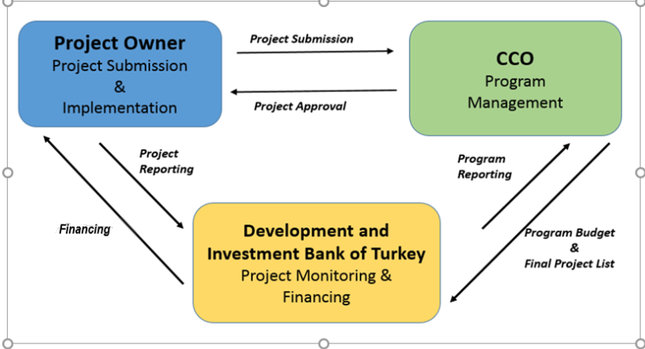
  GENERAL STRUCTURE & PROCESS FLOW
The Bank and CCO are not responsible for the implementation of project activities. Responsibility for the implementation of the project activities rests only with the PO.
COMCEC
3
COORDINATION
OFFICE
3

Slide 4
  MONITORING & REPORTING
RIGHTS, OBLIGATIONS AND RESPONSIBILITIES OF THE BANK
The CCO and the Bank monitors the implementation of the Project in line with the Contract and the Guidelines.
The Bank performs efficient monitoring via document reviews, monitoring visits and on the spot checks in cooperation with the CCO.
The Bank also monitors project activities in terms of risks related to project implementation and informs the CCO accordingly if any problem occurs during project implementation.
The Bank provides information to the Coordination Committee about technical and financial progress of the Project.
COMCEC
4
COORDINATION
OFFICE

Slide 5
  FINANCING THE PROJECT: THE ACCOUNT INFORMATION
If the aforementioned account is not opened before the signature of the Contract, Project Owner is obliged to inform the bank account number within 30 days after the signature date.
In case the Project Owner institution is not authorized to open/have a bank account regarding the relevant country legislation, an acceptable account number for the payments shall be informed to the Bank within 30 days after the signature date.
The Bank cannot be claimed for the payments, if the relevant account number is not stated in the Service Contract or it is not informed officially within the given time periods.
The Bank cannot be claimed for any additional cost which would arise due to incorrect bank account information provided by the Lead Project Owner, Project Coordinator or Trainers Researcher. Any additional cost would be offset from the payment in question.
The Project Owner, in any case, can not request additional financing that is not stated in the budget section of the project fiche.
COMCEC
5
COORDINATION
OFFICE

Slide 6
  FINANCING THE PROJECT: THE ACCOUNT INFORMATION
COMCEC
6
COORDINATION
OFFICE

Slide 7
  FINANCING THE PROJECT: THE ACCOUNT INFORMATION
Development and Investment Bank of Turkey
Correspondent Bank of Our Bank
Correspondent Bank of PO Bank
Project Owner Bank
1
2
3
4
If the account information of the PO/coordinator/trainer is wrong, the money comes back to the Bank with cut.
COMCEC
7
COORDINATION
OFFICE

Slide 8
  FINANCING THE PROJECT: REPORTING
 | Name of the report | Responsible for preperation | Responsible for signing | Presented to | Frequency or when | Explanation
 | Monthly Progress Report | Project Coordinator | PO (RA) | CCO | Within one week after the last day of each month | Technical progress of project activities
 | Timesheet | Project Coordinator and Trainer | PO (RA) | Bank | Within one week after the last day of each month | The Project Coordinator and the Trainer(s) shall prepare his/her own Timesheets that shows weekly tasks performed by each project personnel in the relevant month.
 | Financial Progress Report (FPR) | Project Coordinator | PO (RA) | Bank | Within two weeks after the last day of the month (*) | Shows details about expenditures made during respective period Includes separate sheets for different expenditures in line with the budget USD/Local Currency exchange rate should be stated in the relevant sheet Necessary documents ( etc.) that verify the expenditures will be attached to FPR
 | Activity Report | Project Coordinator in collaboration with the Trainer (if available) | PO (RA) | CCO | Within two weeks after the last day of the month (*) | Shows the works performed during each main activity as well as their evaluations.
 | Project Completion Report | Project Coordinator in collaboration with other project personnel (if available) | PO (RA) | CCO | Within two weeks after all project activities are completed. | Summarizes all technical information about the implementation of the project.
(*) if a main activity is undertaken in the respective month
COMCEC
8
COORDINATION
OFFICE

Slide 9
  FINANCING THE PROJECT: TIMESHEETS
PO submits Timesheet(s) of the Project Coordinator and the Trainer(s) (if a training program is conducted in the respective month) within one week after the last day of each month during the project implementation period.
The Project Coordinator and the Trainer(s) shall prepare their own Timesheets which must be approved (checked and signed) by the Responsible Authority.
Timesheets provide a basis for payments to project personnel and show the weekly tasks performed by each project personnel in the relevant month. The number of days worked, location, detailed description of tasks, linkage with the activities and per diems of the project personnel must be stated in timesheets by considering the relevant budget items.
Timesheets should be prepared in accordance with the relevant Monthly Progress Report and Activity Report (if available).
COMCEC
9
COORDINATION
OFFICE

Slide 10
  FINANCING THE PROJECT: FINANCIAL PROGRESS REPORTS
Financial Progress Report is the document that shows details about expenditures made during respective period. Financial Progress Report includes separate sheets for providing information regarding different expenditures in line with the project budget.
All expenditures should be stated in the relevant sheet using the USD/Local Currency exchange rate at the date of transaction. Necessary documents (invoices, etc.) that verify the expenditures will be attached to Financial Progress Report.
PO submits a Financial Progress Report within two weeks after the last day of the month if a main activity is undertaken in the respective month.
Financial Progress Report shall be prepared by Project Coordinator and approved (checked and signed) by Responsible Authority.
COMCEC
10
COORDINATION
OFFICE

Slide 11
  ADDENDUM PROCEDURE AND NOTIFICATION PROCESS
Addendum Form (Annex 8)
PO submits an Addendum Form (Annex 8) to request a change on the basics (work plan, activities, and transfer among budget items over 1.000 USD etc.) of the project.
However, the PO cannot make a transfer from other budget items to human resources item under any circumstances.
The Addendum Form, must be submitted at least one month before the respective activity is implemented.
Addendum Form is subject to approval of the CCO.
Notification Form (Annex 9)
PO submits a Notification Form for transfers between budget items up to 1.000 USD. The Form must be signed by the Contact Person and sent to the Bank.
COMCEC
11
COORDINATION
OFFICE

Slide 12
  ADDENDUM PROCEDURE AND THE USE OF INCIDENTIALS BUDGET ITEM
Responsible Authority shall initiate the addendum procedure if it wants to change the basics (work plan, activities, transfer between budget items etc.) of the project.
He/she must fill the Addendum Form (given in Annex Section) and convey it to CCO and the Bank for evaluation of the request.
The PO cannot transfer funds from other budget items to human resources budget item.
The Incidentals budget item can only be used upon the approval of the CCO and the Bank via addendum procedure.
The addendum request must be justified by rational explanations in order to be approved and it must be submitted to the CCO and the Bank at least a month before the respective activity.
COMCEC
12
COORDINATION
OFFICE

Slide 13
THE CONTRACT ANNEXES
Activity-Based Projects
Project Fiche (Annex 1)
Template for Declaration of the Responsible Authority of the Project Owner (Annex 2)
Monthly Progress Report Template (Annex 3)
Irregularity Report Template (Annex 4)
Financial Progress Report Template (Annex 5)
Timesheet Template for Project Coordinator and Trainer(s) (Annex 6)
Detailed Work Plan Template (Annex 7)
Addendum Form (Annex 8)
Notification Form (Annex 9)
Service Contract Template for Project Coordinator and Trainer(s) (Annex 10)
Template for Project Completion Report (Annex 11)
Activity Report Template (Annex 12)
Payment Control Form-Checklist tool for Financial Progress Report
COMCEC
6
13
COORDINATION
OFFICE

Slide 14
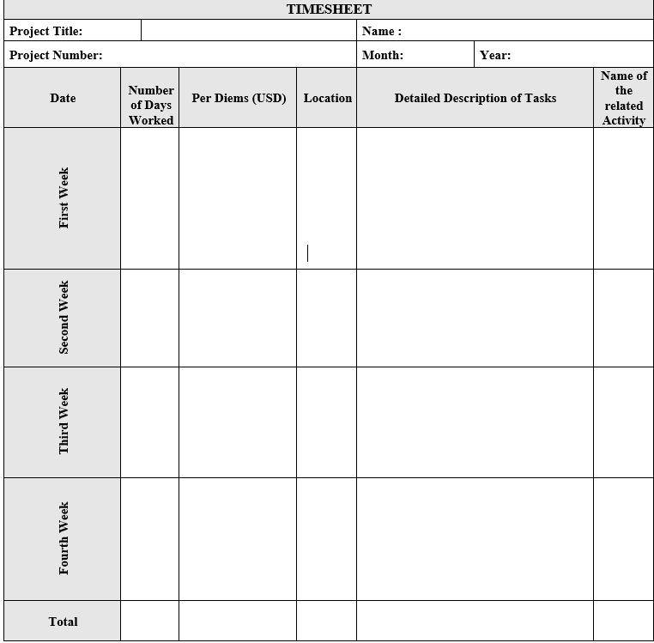
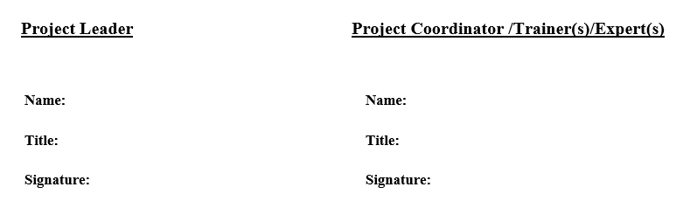
  TIMESHEETS
ANNEX- 6 TIMESHEETS
Maximum total of 22 days
per month !
COMCEC
14
COORDINATION
OFFICE

Slide 15
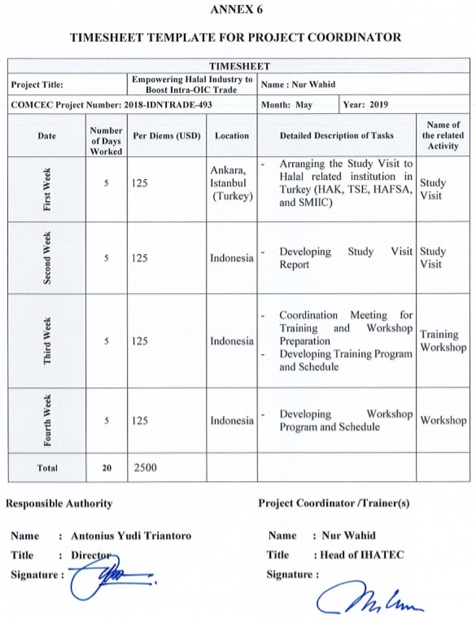
  TIMESHEETS
ANNEX- 6 TIMESHEETS
COMCEC
15
COORDINATION
OFFICE

Slide 16
  FINANCIAL PROGRESS REPORT
ANNEX-5 DISBURSEMENT REQUEST FORM
COMCEC
16
COORDINATION
OFFICE

Slide 17
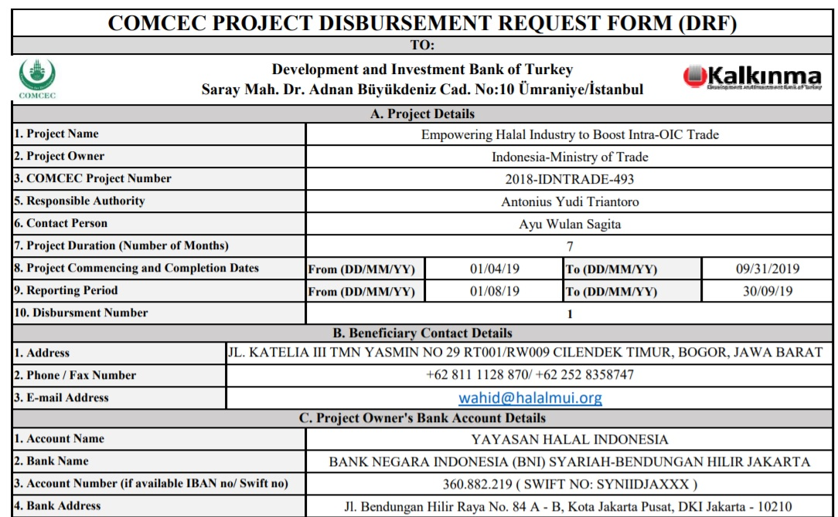
  FINANCIAL PROGRESS REPORT
DISBURSEMENT REQUEST FORM-PART I
COMCEC
17
COORDINATION
OFFICE

Slide 18
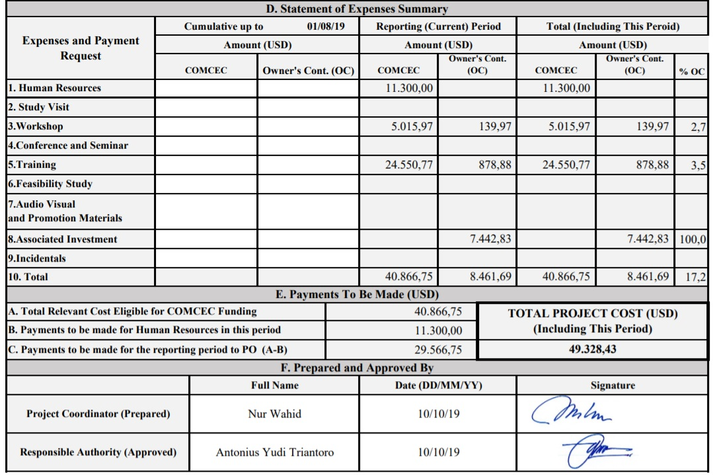
  FINANCIAL PROGRESS REPORT
DISBURSEMENT REQUEST FORM-PART II
Automatically filled part
Wet inked
COMCEC
18
COORDINATION
OFFICE

Slide 19
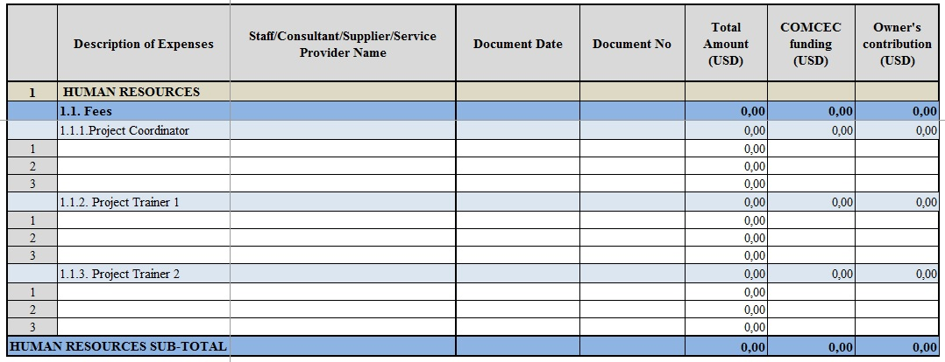
  FINANCIAL PROGRESS REPORT
HUMAN RESOURCES
COMCEC
19
COORDINATION
OFFICE

Slide 20
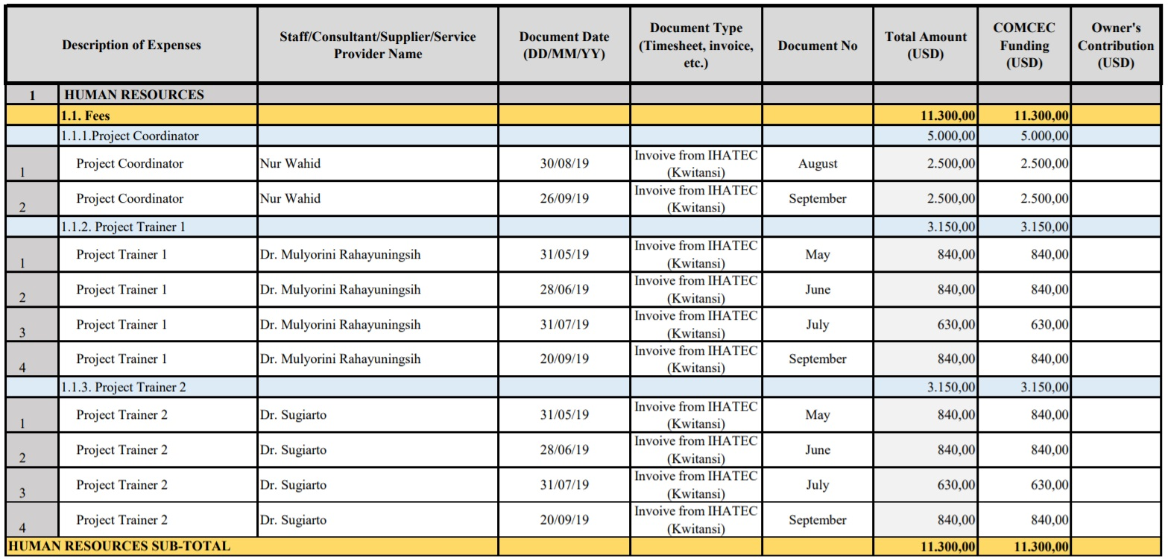
  FINANCIAL PROGRESS REPORT
HUMAN RESOURCES - Example
COMCEC
20
COORDINATION
OFFICE

Slide 21
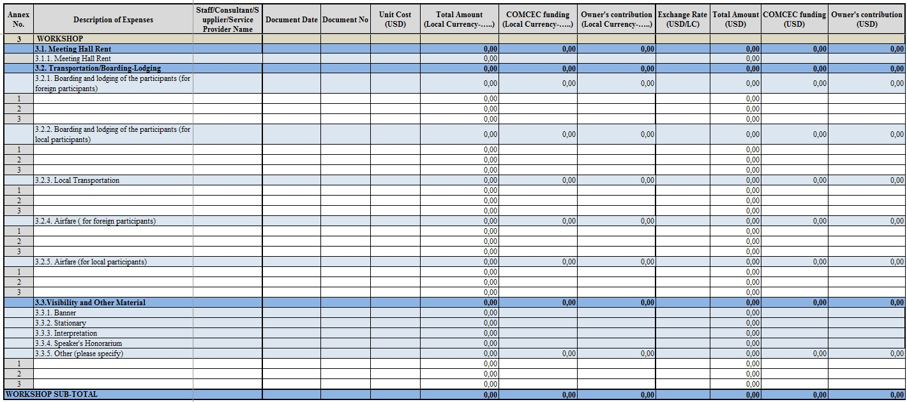
  FINANCIAL PROGRESS REPORT
WORKSHOP
COMCEC
21
COORDINATION
OFFICE

Slide 22
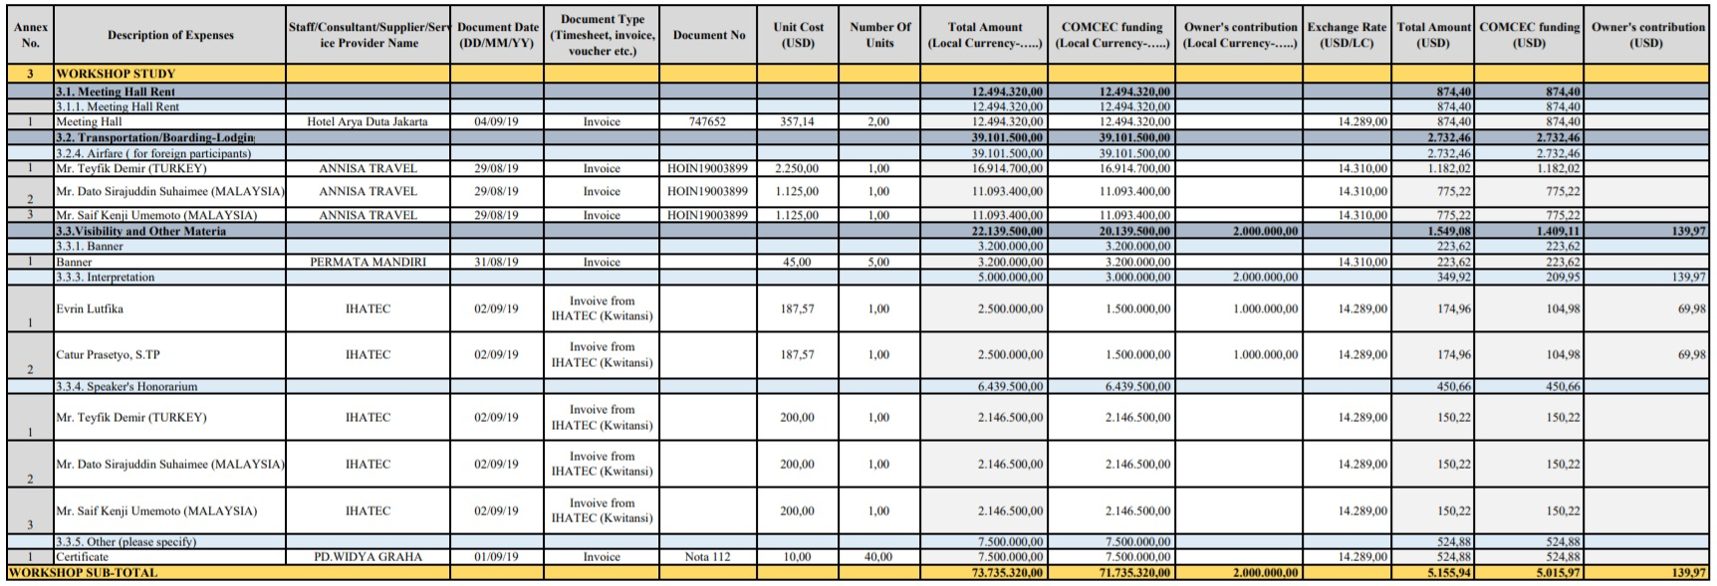
  FINANCIAL PROGRESS REPORT
WORKSHOP - Example
COMCEC
22
COORDINATION
OFFICE

Slide 23
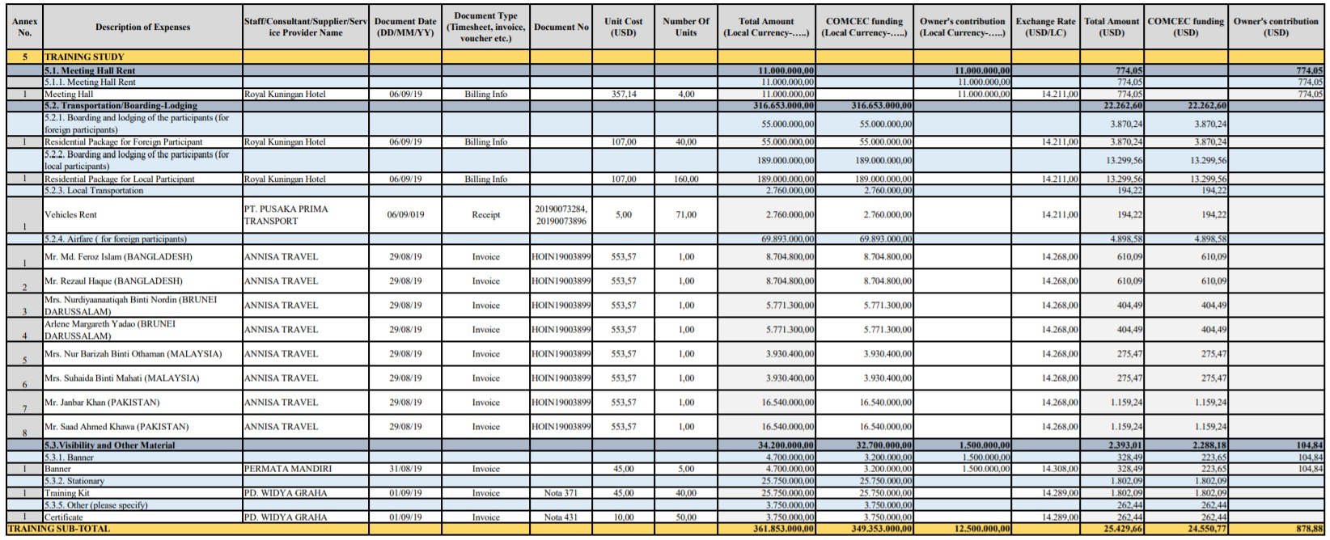
  FINANCIAL PROGRESS REPORT
TRAINING - Example
COMCEC
23
COORDINATION
OFFICE

Slide 24
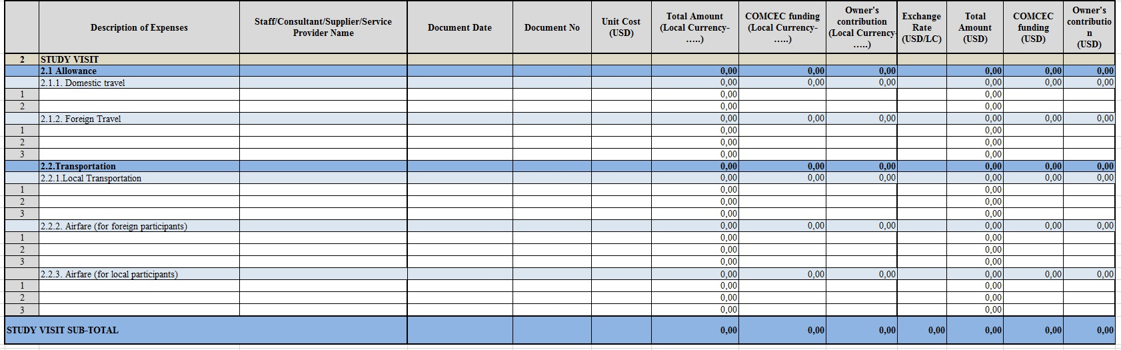
  FINANCIAL PROGRESS REPORT
STUDY VISIT
COMCEC
24
COORDINATION
OFFICE

Slide 25
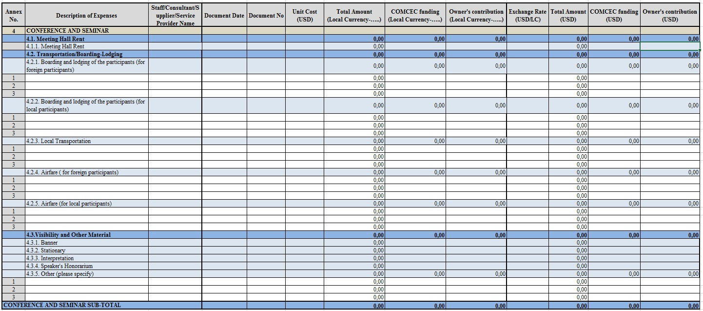
  FINANCIAL PROGRESS REPORT
CONFERENCE AND SEMINAR
COMCEC
25
COORDINATION
OFFICE

Slide 26
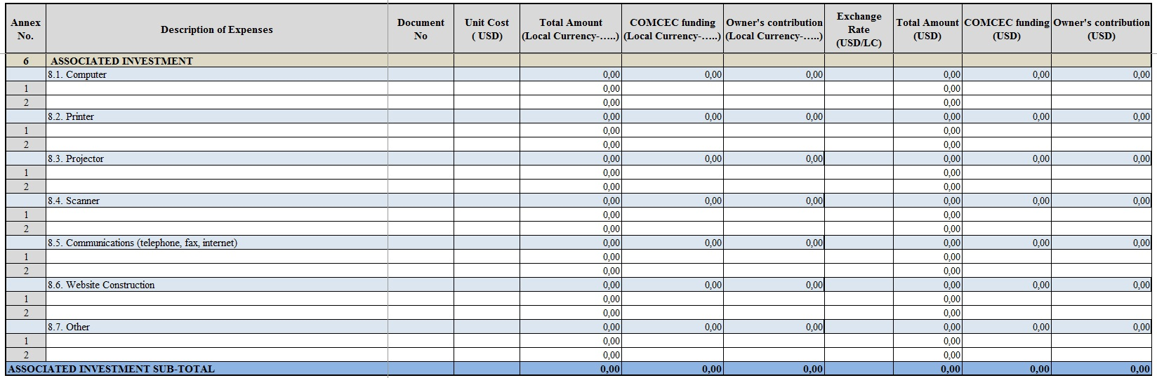
  FINANCIAL PROGRESS REPORT
ASSOCIATED INVESTMENT
COMCEC
26
COORDINATION
OFFICE

Slide 27
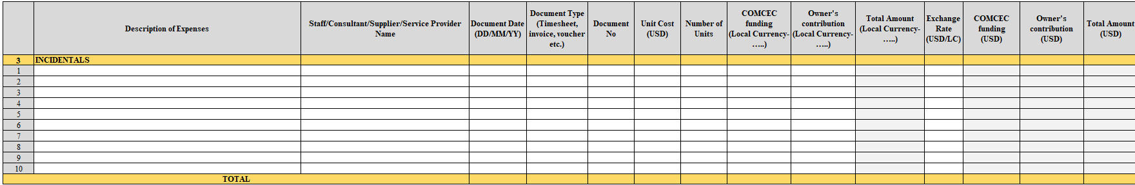
  FINANCIAL PROGRESS REPORT
INCIDENTALS
COMCEC
27
COORDINATION
OFFICE

Slide 28
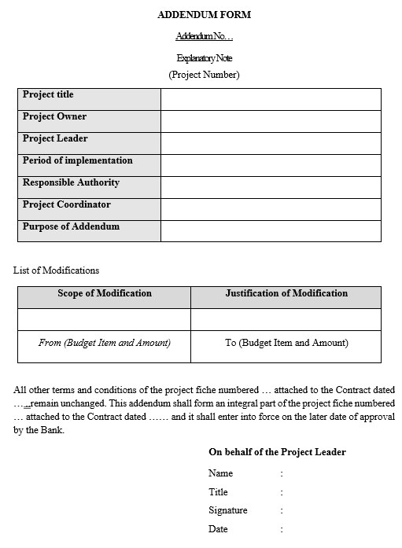
  ADDENDUM FORM
ANNEX- 8 ADDENDUM FORM
COMCEC
28
COORDINATION
OFFICE

Slide 29
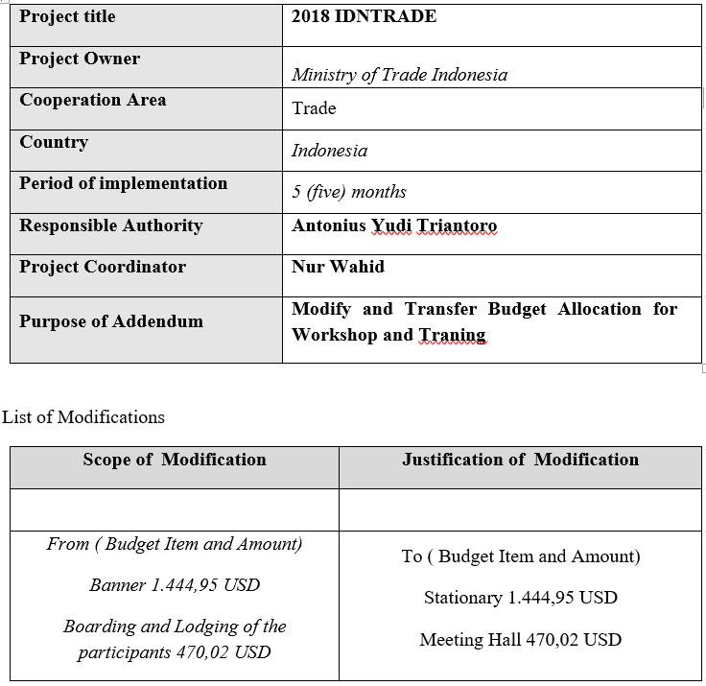
  ADDENDUM FORM
ANNEX- 8 ADDENDUM FORM
COMCEC
29
COORDINATION
OFFICE

Slide 30
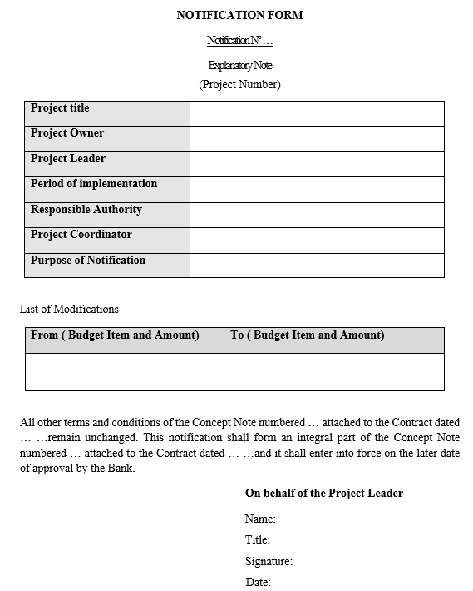
  NOTIFICATION FORM
ANNEX- 9 NOTIFICATION FORM
COMCEC
30
COORDINATION
OFFICE

Slide 31
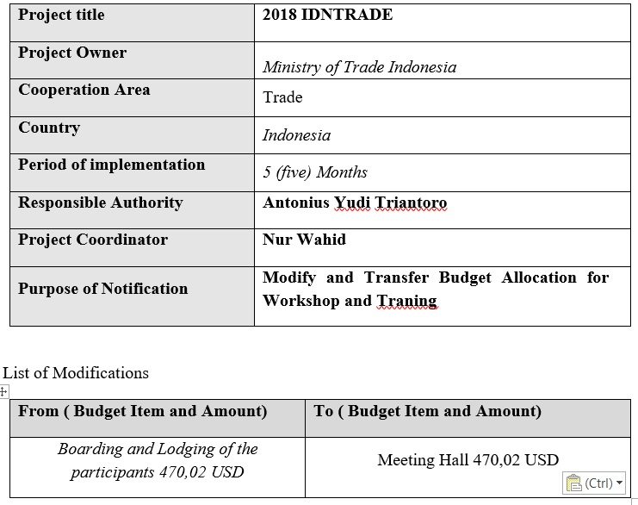
  NOTIFICATION FORM
ANNEX- 9 NOTIFICATION FORM
COMCEC
31
COORDINATION
OFFICE

Slide 32
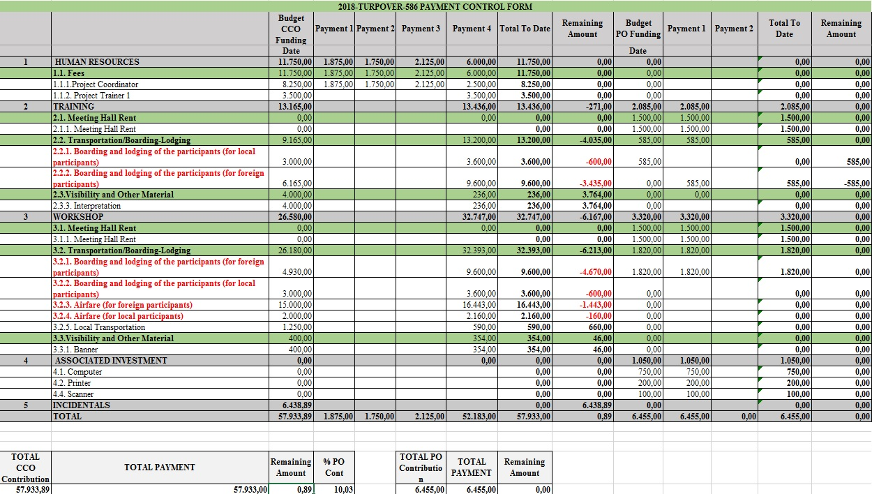
BUDGET AND CONTROL FORM - SAMPLE
COMCEC
32
COORDINATION
OFFICE

Slide 33
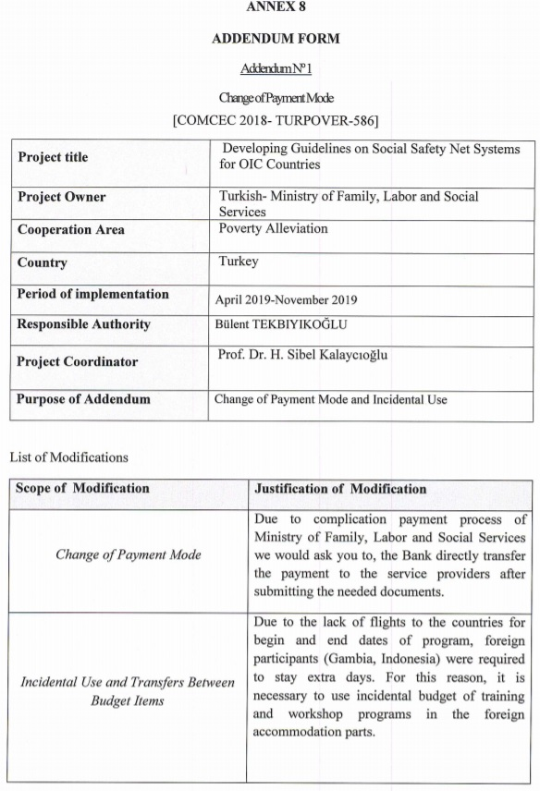
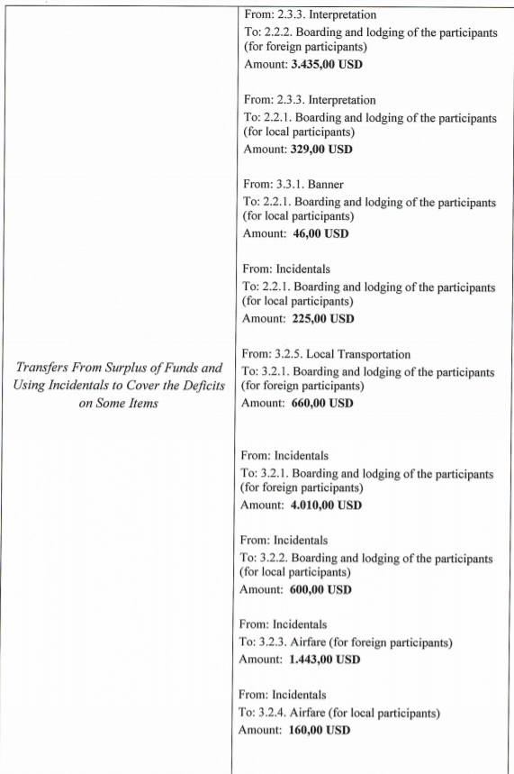
ADDENDUM FORM
COMCEC
33
COORDINATION
OFFICE

Slide 34
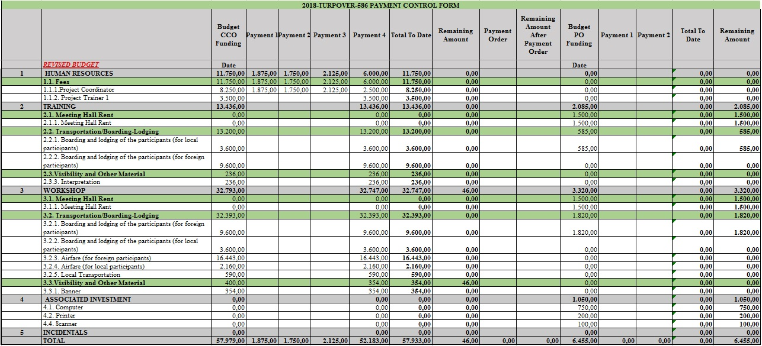
REVISED BUDGET
COMCEC
34
COORDINATION
OFFICE

Slide 35
REPORTS/DOCUMENTS REQUIRED TO BE DELIVERED IN HARD COPY
Documents that form basis for the payments/make significant changes in the Project are required to be delievered to the Bank in hard copy.
The Contract
Financial Progress Reports
  Financial Progress Report and it’s annexes (Report+Annexes+verifying expenditure documents-invoices, airfare tickest etc.)
Timesheets
Addendum Form (if applicable)
Notification Form (if applicable)
COMCEC
35
COORDINATION
OFFICE

Slide 36



THANK YOu
recai.biberoglu@kalkinma.com.tr
selma.demirci@kalkinma.com.tr
mehmet.caylidemirci@kalkinma.com.tr
eren.dusgun@kalkınma.com.tr
naz.gunduz@kalkinma.com.tr
ilker.kocak@kalkinma.com.tr
ender.irkoren@kalkinma.com.tr>
havvaece.gulsevendagdemir@kalkinma.com.tr
handenur.sahin@kalkinma.com.tr
zerdi.guler@kalkinma.com.tr
bankcpf@kalkinma.com.tr
cpf@comcec.org
COMCEC
COORDINATION
OFFICE
36

